Slide 1
BIFX 503: Biostatistics in R
Instructor: Jennifer Schroeder, Ph.D.
Wednesdays, 5:30-8:15pm
Hodson Technology Center, Room 237
Fall 2021

Slide 2
Content
Analysis of Repeated Measures
Repeated measures ANOVA
Repeated measures regression

Slide 3
Analysis of Repeated Measures

Slide 4
Repeated Measures
Multiple measurements taken on the same study subject
Values are correlated
Violate a key assumption in many statistical methods:
Independence

Slide 5
Ignoring Within-Subject Correlation
Ignoring within-subject correlation can lead to invalid hypothesis test results and incorrect conclusions
Can lead to incorrectly not rejecting H₀ for within-subject comparisons
Can lead to incorrectly rejecting H₀ for between-subject comparisons

Slide 6
Repeated Measures: One Approach
Collapse repeated measures into one summary number per subject
This eliminates the within-subject correlation
Standard analytical methods that assume independent observations can be used

Slide 7
Recall: Paired t Test
Before/after measurements were combined into a single outcome
Post-Pre change score
One-sample t test performed on change score
Null hypothesis: Change = Zero

Slide 8
Other Examples
Other ways repeated measures can be collapsed into a single summary number:
Area under the curve (AUC)
Maximum change from baseline
Time-to-peak
Proportion (or count) over a threshold value

Slide 9
Summarize → Analyze
Advantage:
Simpler methods of analysis
Disadvantage:
Can’t assess patterns of change over time
→

Slide 10
Repeated Measures: Another Way
Outcome as DV, Time and any other relevant variables and interactions as IVs
The covariance structure (how repeated measures are correlated) is built into the model
Repeated measures ANOVA and regression

Slide 11
Repeated Measures ANOVA

Slide 12
Analysis of Variance (ANOVA)
Used to compare two or more group means to see if there are any reliable differences between them
Null and Alternative
H₀: means are all equal
E.g., H₀: μ₁ = μ₂ = μ₃
H_{A}: means are not all equal
Key assumption: Independence between and within groups

Slide 13
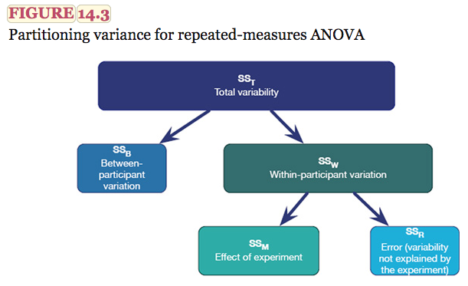
Repeated ANOVA
From Andy Field’s Discovering Statistics Using IBM SPSS-Statistics 4th ed.

Slide 14
Assumptions
Normality
Independence of errors
Even though observations are not!
Sphericity
Variances of differences between treatments are equal
Formally test this using Mauchly’s test
Remedy is an alternative form of F test

Slide 15
Assessing Sphericity
Mauchly’s Test of Sphericity
H₀: condition of sphericity is met
Significant result (p<0.05) means this assumption has been violated and conventional F tests should not be used
The remedy for a lack of sphericity is to use an alternative form of the F test that uses corrected degrees of freedom
Greenhouse-Geisser
Huynh-Feldt
F tests are more conservative when sphericity assumption is violated

Slide 16
Post Hoc Tests
If omnibus test is significant, follow up with pairwise comparisons and alpha adjustment
pairwise.t.test()
Use Bonferroni correction when sphericity is violated

Slide 17
One-Way Repeated ANOVA

Slide 18
One-Way Repeated ANOVA
The simplest example of a repeated ANOVA has only one factor and it is repeated within each experimental unit
Examples:
Multiple treatments given in random order to the same subject
All subjects given the same treatment, with changes observed over time

Slide 19
One-Way Repeated ANOVA in R
aov_ez(id, dv, data, between, within)
“id” is the variable that identifies subject
“dv” is the dependent variable
“data” is the data frame
“between” is the between-subjects factor, e.g. experimental treatment
“within” is the within-subjects factor, e.g. time
Nest within summary() to get full results
Sphericity tests

Slide 20
Alternative Method
aov(y ~ time + Error(Subject), data)
“time” is the variable that identifies time
“Subject” is the variable that identifies the subjects in the dataset
Note: does not provide sphericity test or adjusted F tests

Slide 21
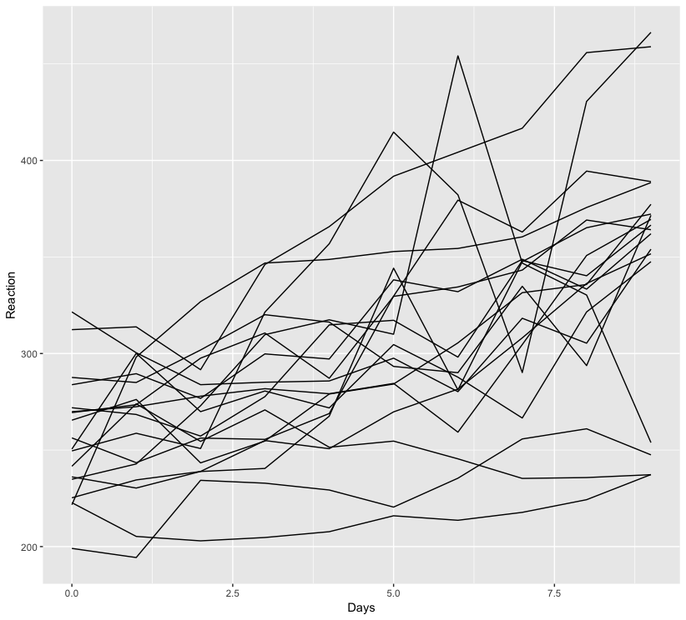
Sleep Deprivation and Reaction Time
Sleep deprivation study
18 study subjects restricted to 3 hours of sleep for 9 consecutive days
Reaction time measured on each successive day of sleep deprivation
Data: sleepstudy from package lme4

Slide 22
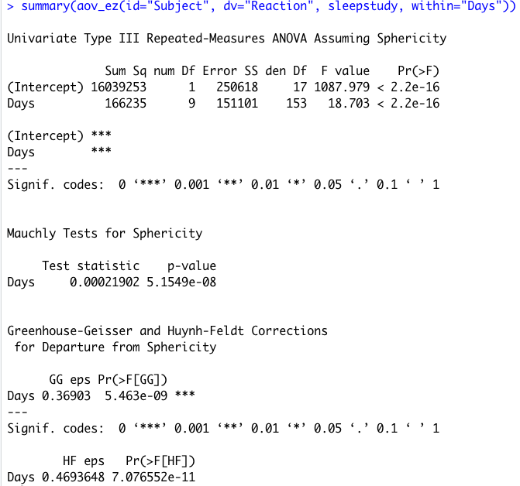
Sleep Deprivation and Reaction Time
Specify model
Results
aov_ez(id=“Subject”, dv=“Reaction”, sleepstudy, within=“Days”)
Sphericity assumption is violated (Mauchly p < 0.05)
Use adjusted F test results
Both give same conclusion
I would choose the more conservative test (GG)

Slide 23
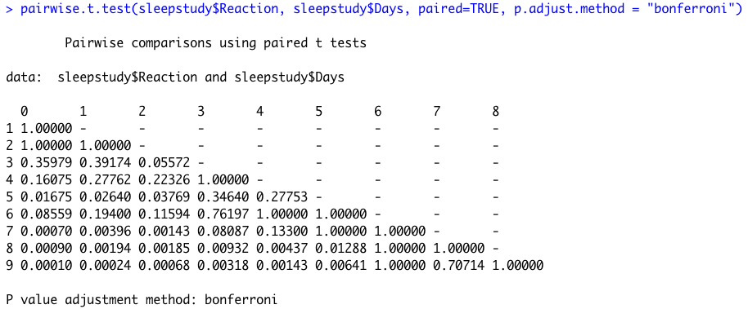
Sleep Deprivation and Reaction Time
Post hoc tests: pairwise comparisons of each time point
Use Bonferroni correction, since sphericity assumption was violated
pairwise.t.test(DV, time, paired=TRUE, p.adjust.method=“bonferroni”)

Slide 24
Mixed Factorial ANOVA

Slide 25
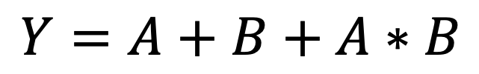
Mixed Factorial ANOVA
$$Y=A+B+A∗B$$
Between-subjects effect and within-subjects effect (“mixed”)
Each IV or factor is composed of different study subjects, but they are assessed repeatedly
Randomize subjects to receive one treatment or another
Assess their response repeatedly to see if the rate of response differs between groups
Often interested in interaction
Does change vary by group?

Slide 26
Interaction Plot
interaction.plot()
Arguments
x.factor: x axis variable (time or within-subjects factor)
trace.factor: grouping variable (treatment or between-subjects factor)
response: y axis variable
fun: summary function (e.g., mean)
type: “l” lines, ”p” points, “b” both

Slide 27
Mixed ANOVA in R
aov_ez(id, dv, data, between, within)
“id” is the variable that identifies subject
“dv” is the dependent variable
“data” is the data frame
“between” is the between-subjects factor, e.g. experimental treatment
“within” is the within-subjects factor, e.g. time
Nest within summary() to get full results
Sphericity tests
aov(y ~ A * B + Error(Subject), data)
interaction model
“A” and “B” are the experimental conditions
“Subject” is the variable that identifies the subjects in the dataset
Use if there are no within-subject effects in model

Slide 28
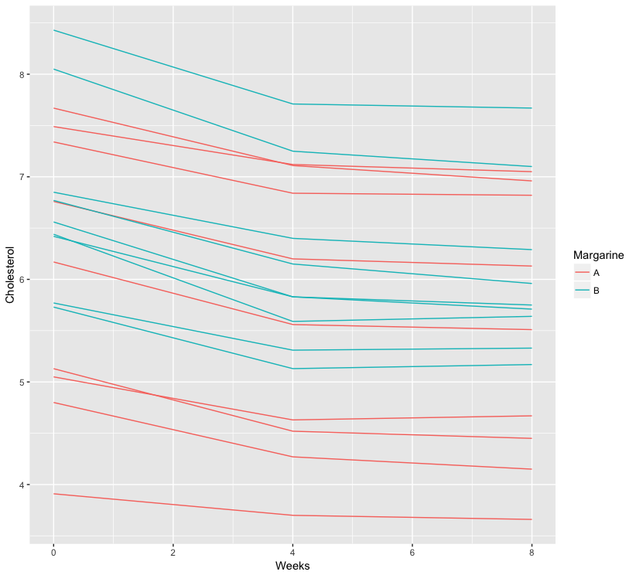
Example: Cholesterol
Does a certain brand of margarine reduce cholesterol as part of a low-fat, low-cholesterol diet?
18 subjects randomized to receive margarine type A or B
Cholesterol measured at three time points:
Before the study
After 4 weeks
After 8 weeks

Slide 29
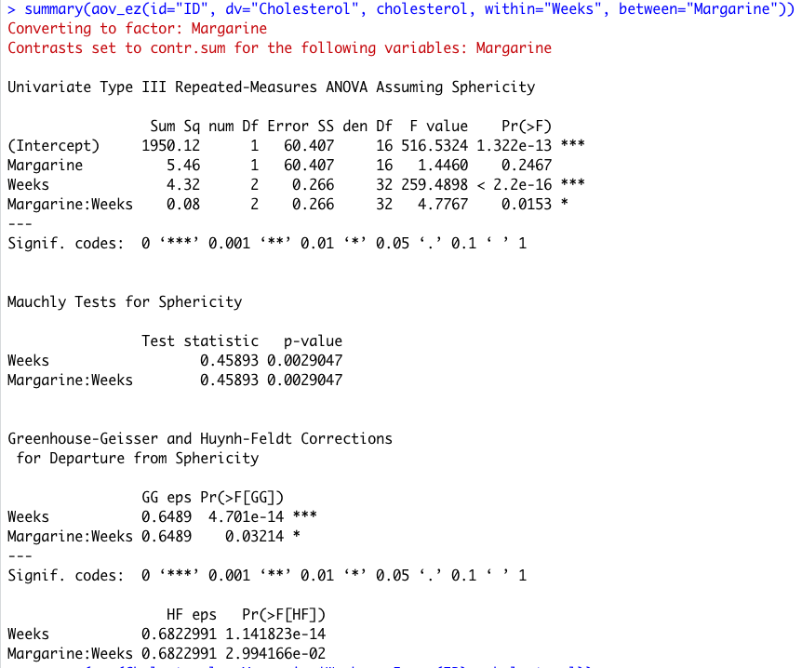
Cholesterol Results
Sphericity assumption violated (p=0.0029)
Don’t use “Sphericity Assumed” F tests
Effect of Week highly significant (p<0.001)
Interaction Week*Margarine is also significant (p=0.032)
Effect of Margarine not significant (p=0.25)
Conclusions
Cholesterol decreases during the study
Treatments similar in terms of decrease

Slide 30
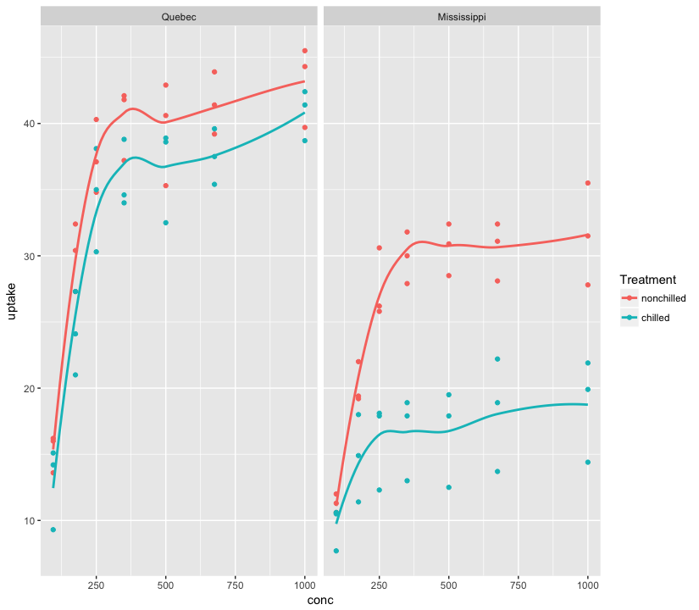
Second Example: CO₂
Experiment of cold tolerance of grass species
Plants either chilled or left unchilled during the night before gas exchange measurements taken
Two different varieties: Quebec, Mississippi
Questions:
Does chilling affect CO₂ uptake
Does CO₂ uptake differ by variety
Does the effect of chilling on CO₂ uptake vary by variety

Slide 31
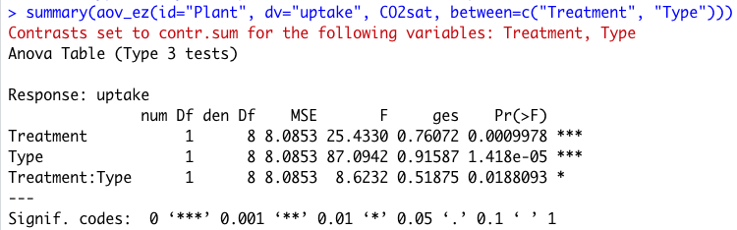
CO₂ Results
Note: get same results using aov() since there are no tests of within-subjects effects, no need to test/account for sphericity

Slide 32
Repeated Measures Regression

Slide 33
Repeated Measures Regression
Time is an independent variable in the model, thus quantifying the effect of time on outcome
Y = β₀ + β₁Time + … + β_{k}X_{k} + e

Slide 34
Repeated Measures Regression
More than one IV predict the DV:
Y is the DV
Time and other X’s are the IVs
β₀ is the intercept
β₁ , β₂, …, β_{k} are the slopes
e is error
Model must include within subject correlation structure
Y = β₀ + β₁Time + … + β_{k}X_{k} + e

Slide 35
New Features
Correlation structure
Random effects
Random intercept
Random slope

Slide 36
Correlation Structures
Accounted for by specifying a correlation structure as part of the model
Modeling the correlation structure is usually not of primary interest
However, specifying it incorrectly can lead to invalid inferences
Can affect overall model fit and SE’s of parameter estimates

Slide 37
Common Types of Correlation Structures
Compound Symmetric (a.k.a. Exchangeable)
Correlation is the same for each pair of observations on a subject (assumed in ANOVA)
Autoregressive
Correlation decreases as observations are farther apart in time
Unstructured
No mathematical pattern imposed on the covariance matrix; possible unique covariance for each pair of observations

Slide 38
Choosing the Best Correlation Structure
Fit model with a few good candidate structures, choose the one that provides the best model fit
Compare fit from competing models
E.g., “Information Criterion” (smaller is better) or precision of parameter estimates
Good rule of thumb: If fit is comparable, choose the simpler correlation structure

Slide 39
Random Effects
Marginal models
Regression coefficients reflect the average effect
Inference about the population
Random effects models
Regression coefficients vary from one participant to the next
Inference about the individual as well as population
Choice depends on scientific objective

Slide 40
Marginal Models
Regression coefficients reflect the average effect, taking into account within-subject correlation
Fixed effects
Inference at the population level
E.g. you want to estimate the average difference for a control group vs. treatment group, not the difference for any individual subject

Slide 41
Random Effects
A random effect is one in which the observed levels of the independent variable are a random sample of all possible levels
A separate estimate is made for each participant
Inference about individuals
Contrast with fixed effects, where the levels in the study represent all levels of interest
One overall estimate is made, which represents the average observed for the sample
Inference about a population
The “mixed” aspect of a mixed regression model refers to the mixture of random and fixed effects

Slide 42
Random Coefficients
Idea: Realistic way of modeling natural heterogeneity among subjects, e.g. CD4 decline in HIV+ individuals
Random Intercept model
Each subject has his/her own unique baseline CD4 count but change over time is the same (generalizable) across subjects
Random Intercept + Random Slope
Each subject has a unique baseline and a unique rate of change
A repeated measures regression model can include both fixed and random effects

Slide 43
Interpretation of Results
Regression output provides a parameter estimate for each IV in the model (β’s)
β quantifies the strength of association between each IV and the DV, after accounting for all other IVs
The sign of β indicates whether the association is positive of negative
The magnitude of β is the change in the DV that would be expected from a one-unit change in the IV, if all other IVs are held constant
The precision of each parameter estimate is also provided:
Standard error, confidence intervals
Statistical test (H₀: β=0)

Slide 44
Inference
Overall model
Model fit: AIC, BIC
Contribution of individual IVs
t-test to determine if coefficient=0
confidence limits on the coefficient (include 0?)

Slide 45
Repeated Measures Regression Assumptions
Subjects are representative of one population
Each subject has Y and X’s
X’s and Y measured independently
Y has a Normal distribution
X’s may be continuous or categorical
The relationship between Y and each X is linear

Slide 46
Repeated Measures Regression in R
Package | nlme | lme4 | geepack
Functions | gls() lme() nlme() | lmer() glmer() nlmer() | geeglm()
Correlation structure | Yes | No: within-subject correlation is handled by including random effects | Yes, but no fit indices for comparison (not likelihood based)
Random effects | Yes | Yes | No
Non-normal DV (binary, count) | No | Yes | Yes
No single method “does it all” so you should have a working knowledge of all three packages

Slide 47
Syntax for geeglm()
Marginal model: No random effects
Flexible enough to accommodate non-normal DV
Argument (family=)
Options include “binomial”, “poisson”, “gaussian”
Can specify correlation structure (corstr=)
Options include “exchangeable”, “ar1”
No fit statistics to judge which is best fit
geeglm(Y ~ time, data, id=subject, corstr=“exchangeable”)
Data must be sorted by participant + time

Slide 48
Syntax for gls()
Allows different correlation structures as well as fixed and random effects
Normal DVs only
gls(Y ~ time, data, corr=[see below])
Specifying different correlation structures
Compound symmetry structure
corr = corCompSymm(form = ~ 1 | subject)
Autoregressive
corr = corAR1(form = ~ 1 | subject)
Unstructured
corr = corSymm(form = ~ 1 | subject)

Slide 49
Syntax for lmer()
Allows random intercept and slope(s)
Within-subject correlation is modeled this way rather than by specifying correlation structure
Can accommodate non-normal DVs
lmer(Y ~ time + 1 | subject, data)
Random intercept
lmer(Y ~ time + time | subject, data)
Random intercept and slope

Slide 50
Example 1: Sleep Deprivation and Reaction Time
Sleep deprivation study
18 study subjects restricted to 3 hours of sleep for 9 consecutive days
Reaction time measured on each successive day of sleep deprivation
Notice differences in starting point and change over time for different study subjects

Slide 51
Example 1: Sleep Deprivation and Reaction Time
geeglm(): Find best correlation structure for the data
Compound symmetry, Autoregressive, Unstructured
Run the model with each structure, compare
lmer(): Evaluate random effects
Compare the results of each best fit model with the “naïve” model that ignores within-subject correlation

Slide 52
Example 1: Best Correlation Structure (geeglm)
Exchangeable
SE(β) = 1.50
Autoregressive
SE(β) = 1.45
Best -> Most precision
Unstructured
SE(β) = 2.64
GEE does not provide fit statistics (e.g. AIC) to easily compare fit of different correlation structures
Fortunately, GEE parameter estimates are robust to mis-specification of correlation structure (Agresti, 2002)
Note the “unstructured” option generally does not work well with GEE and is not recommended; simpler structures produce better results

Slide 53
Example 1: Random Effects (lmer)
Fit two versions of the model
Random intercept only
Random intercept plus random slope
Compare fit using anova()
AIC lower for random intercept + slope model
Difference in fit is significant (p<0.0001)
Adding random slope improves fit

Slide 54
Example 1: Results Comparison
Method | Model | Model fit (best) | β ± SE(β)
geeglm() | Autoregressive correlation | N/A | 10.5 ± 1.45*
lmer() | Random intercept + slope | AIC=1756 | 10.5 ± 1.55*
lm() | Naïve model (ignore correlation) | R squared = 0.28 | 10.5 ± 1.24*
* Significantly different from zero (p<0.05)
Point estimates (β’s) same for all models
Difference is in the precision of the estimates (SE’s)
All models gave same conclusion (significant effect of time)
Random intercept + random slope model seems most realistic, given the trends we see in the figure

Slide 55
Example 2: Cholesterol Study
Does a certain brand of margarine reduce cholesterol as part of a low-fat, low-cholesterol diet?
18 subjects randomized to receive margarine type A or B
Cholesterol measured at three time points:
Before the study
After 4 weeks
After 8 weeks

Slide 56
Example 2: Best Correlation Structure (geeglm)
Exchangeable
SE(β) = 0.51, 0.00625, 0.009
Slightly better?
When two are equivalent, choose the simpler
Autoregressive
SE(β) = 0.52, 0.00625, 0.009
Unstructured
SE(β) = 0.52, 0.0094, 0.014

Slide 57
Example 2: Random Effects (lmer)
Fit two versions of the model
Random intercept only
Random intercept plus random slope
Compare fit using anova()
AIC lower for random intercept model
Difference in fit is not significant (p=0.53)
Adding random slope does not improve fit

Slide 58
Example 2: Results Comparison
Method | Model | Model fit (best) | β ± SE(β)
geeglm() | Exchangeable correlation | N/A | Tx 0.72 ± 0.51 Wk -0.07 ± 0.006* Tx*Wk -0.02 ± 0.01
lmer() | Random intercept | AIC=74.7 | Tx 0.72 ± 0.53 Wk -0.07 ± 0.01* Tx*Wk -0.02 ± 0.01
lm() | Naïve model (ignore correlation) | R squared = 0.08 | Tx 0.72 ± 0.48 Wk -0.07 ± 0.07 Tx*Wk -0.02 ± 0.09
* Significantly different from zero (p<0.05)
Point estimates (β’s) same for all models
Difference is in the precision of the estimates (SE’s)
Models that accounted for within-subject correlation had more precision for within-subject effect and interaction

Slide 59
Binary Dependent Variable
Marginal model: geeglm()
gee(Y ~ time, data, id=subject, family=binomial, corstr=“exchangeable”)
Data must be sorted by participant + time
Random effects model: glmer()
glmer(Y ~ time + (1|subject), data, family=binomial())
fixef() to get coefficients for fixed effects
exp(fixef()) to get odds ratios for fixed effects

Slide 60
Example 3: Respiratory Treatment
Data respiratory
Clinical trial of treatment for respiratory illness
Outcome: status (good or poor) at baseline and monthly for 4 months
Independent variables: treatment (treatment or placebo), age, gender, centre
54 participants received active treatment, 57 placebo
Is treatment effective?

Slide 61
Example 3: Respiratory Treatment
Three models:
Marginal model (GEE): fixed effects only, exchangeable correlation structure
Random effects model: random intercept
“Naïve” model, logistic regression ignoring within-subjects correlation
Compare results

Slide 62
Example 3: Results Comparison
Method | Model | Model fit | Effect of Treatment
geeglm() | Exchangeable correlation | N/A | Β = 1.30 ± 0.35* OR = 3.67
glmer() | Random intercept | AIC = 446.6 | Β = 2.17 ± 0.55* OR = 8.73
lm() | Naïve model (ignore correlation) | AIC = 495.2 | Β = 1.30 ± 0.24* OR = 3.67
* Significantly different from zero (p<0.05)
Treatment effect same for marginal model and naïve model
Random effects model had better fit and different treatment effect estimate – why?
Random effects estimate is conditional upon the participant’s random effect

